Slide 1
How Significant is Quantum Tunnelling in our Daily Life

Slide 2
What is quantum tunnelling?
Quantum Tunnelling is when a particle penetrates an energy barrier with higher energy than its own
This happens because Newtonian Physics do not work at the quantum scale and working with time becomes a lot more complex due to Heisenberg’ s Uncertainty Principle
Heisenberg’ s Uncertainty Principle states that at a specific moment in time we can know either the speed or the position of a particle

Slide 3
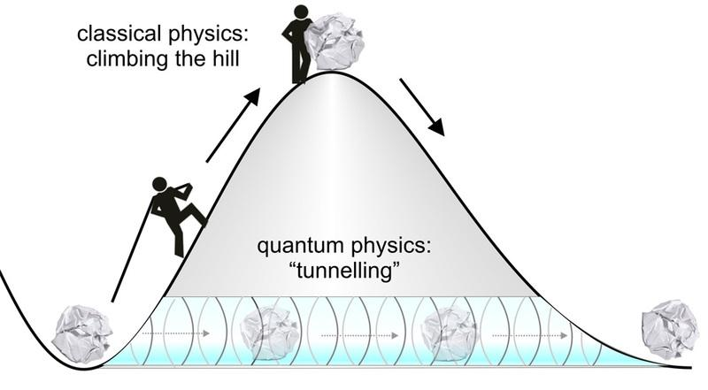
What does quantum tunnelling look like?
Here’s an analogy of quantum tunnelling:
Think of a ball as a particle and the hill as a potential energy barrier
Instead of putting energy into a system to get a ball over a hill, the ball can just ‘teleport’ through the hill disappearing from one side and reappearing on the other without providing the system with any energy

Slide 4
History of Quantum Tunnelling
1972- Friedrich Hund made the first analysis of QT(Quantum Tunnelling) as he solved Schrodinger's equation
1932 – George Uhlenbeck observed the first molecular tunnelling of hydrogen atoms in ammonia
1957 – Leo Esaki showed that electrons could tunnel through a thin insulating barrier in a semi-conductor by carrying out the tunnel junction experiment
1962 – Ivar Giaever carried out Esaki’s experiment using germanium and silicon and found that magnitude of tunnel current is related to the distance between the two elements
1962 - Brian Josephson repeated Giaever’s experiment this time measuring tunnel currents of cooper pairs where he discovered that at 0V there was a supercurrent that travelled through the tunnel junction and when a voltage passed the supercurrent began to oscillate

Slide 5
Where does quantum tunnelling happen?
Quantum tunnelling happens in:
Stars – most of the fusion in stars can happen due to quantum tunnelling making it vital for providing energy to all life on Earth
Transistors – in small transistors quantum tunnelling becomes a problem a lot of energy escapes, requiring more energy needed to be put in to make them function
Enzymes – transferring hydrogen ions (protons) between the acidic and basic sites where substrates require a lot of energy to break bonds between atoms

